Slide 1
Clustering Case Study
HELP International is an international humanitarian NGO that is committed to fighting poverty and providing the people of backward countries with basic amenities and relief during the time of disasters and natural calamities. It runs a lot of operational projects from time to time along with advocacy drives to raise awareness as well as for funding purposes.
After the recent funding programs, they have been able to raise around $ 10 million. Now the CEO of the NGO needs to decide how to use this money strategically and effectively. The significant issues that come while making this decision are mostly related to choosing the countries that are in the direst need of aid.
The objective is to categories the countries using some socio-economic and health factors that determine the overall development of the country and suggest to CEO the list of country to focus on.
Created by-
Sandip Patra

Slide 2
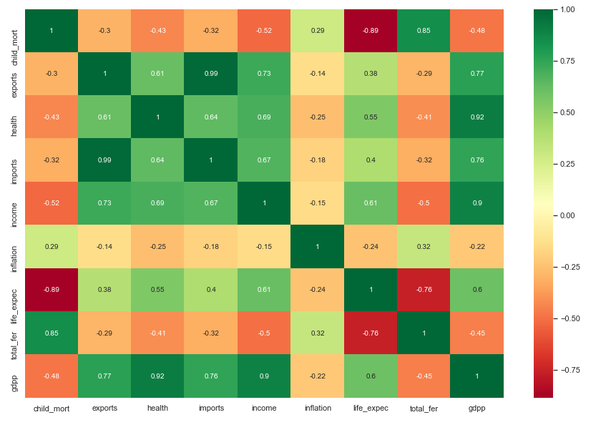
Correlation Analysis
Points to be concluded:
Child mortality is also in strong negative correlation with life expectancy.
Child mortality is highly correlated with total fertility with the correlation coefficient of 0.85
Life expectancy has strong negative correlation with total fertility of about -0.76

Slide 3
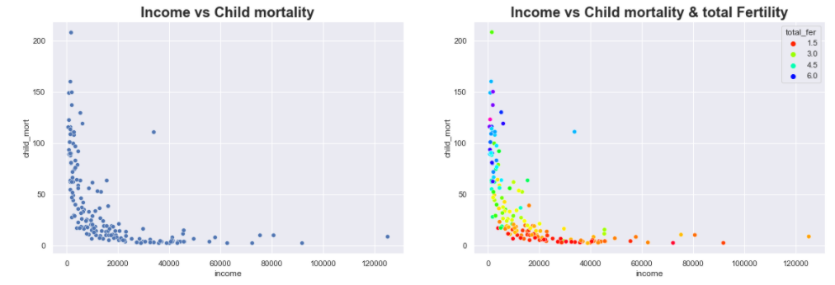
Income vs Child Mortality Analysis
From the plots above We can see that low income people have high child mortality, which means death of children under age 5 is more, where there is a low income
In the second plot we can see that, high fertility rate for a woman and low income have high child mortality

Slide 4
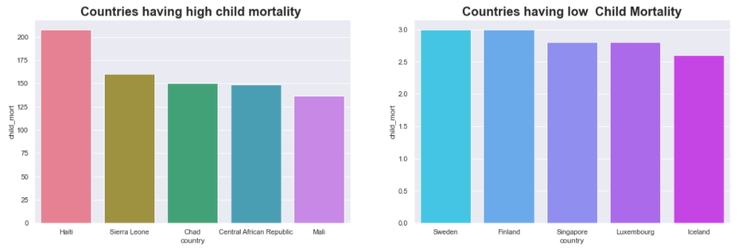
Country vs Child Mortality
Haiti is a country with highest child mortality of around 208 out of 1000 live births. Next comes Sierra Leone
Iceland, Luxembourg, Singapore are the countries with less child mortality

Slide 5
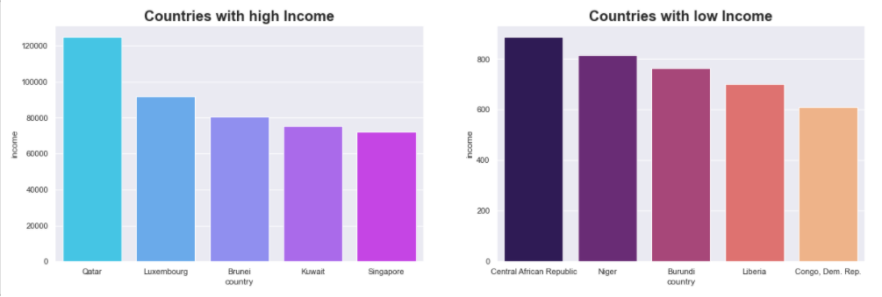
Country vs Income
Net income per person is more in Qatar which is 125000
Congo, Democratic Republic and Liberia has less income.

Slide 6
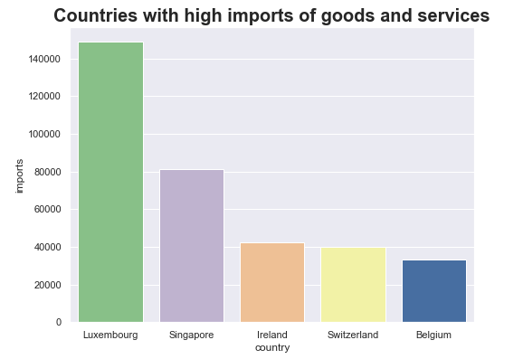
Country vs Imports
Luxembourg has most imports of goods and services of about 149100 per capita
Myanmar has very less import of goods and services of about 0.6511 per capita

Slide 7
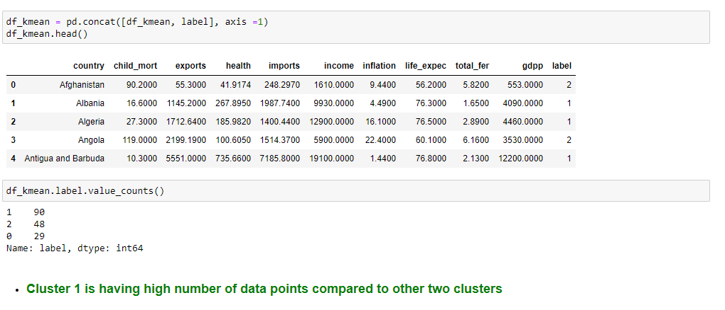
K-mean clustering

Slide 8
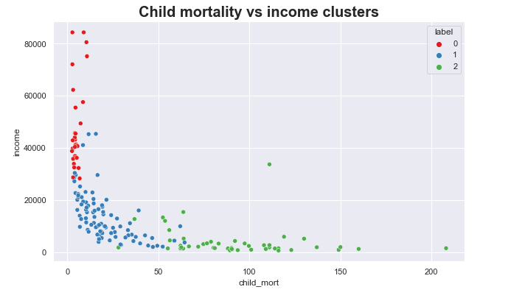
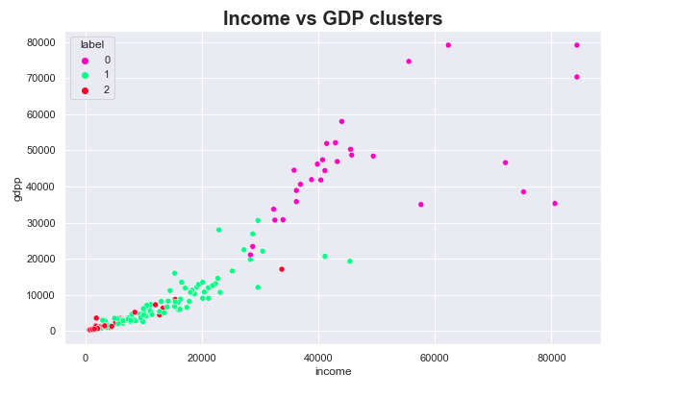
Plotting the clusters

Slide 9
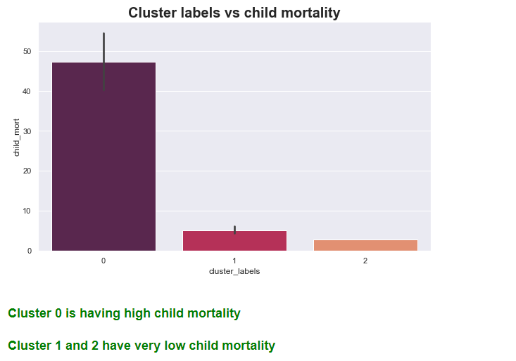
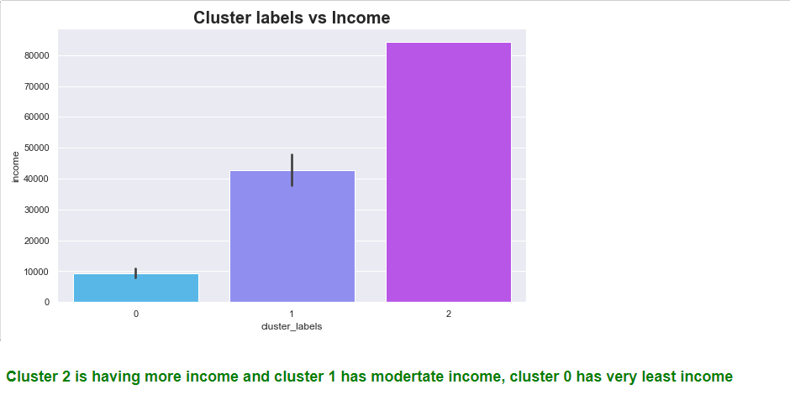
Hierarchical Clustering

Slide 10
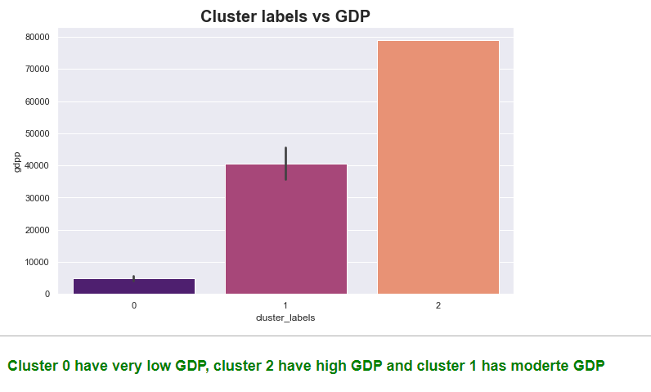
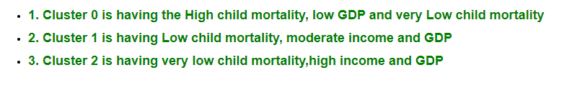
Observations-

Slide 11
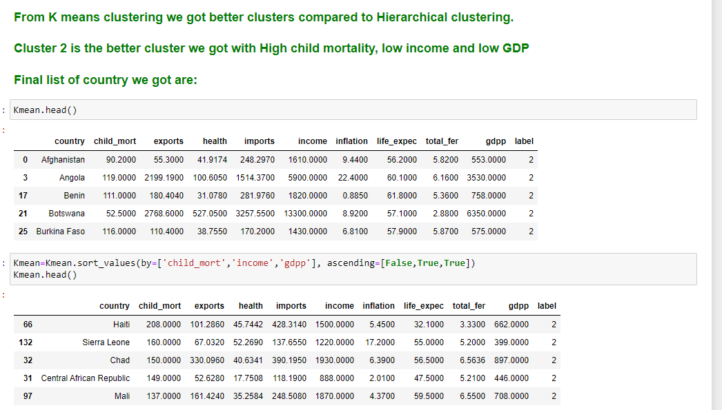

Slide 12
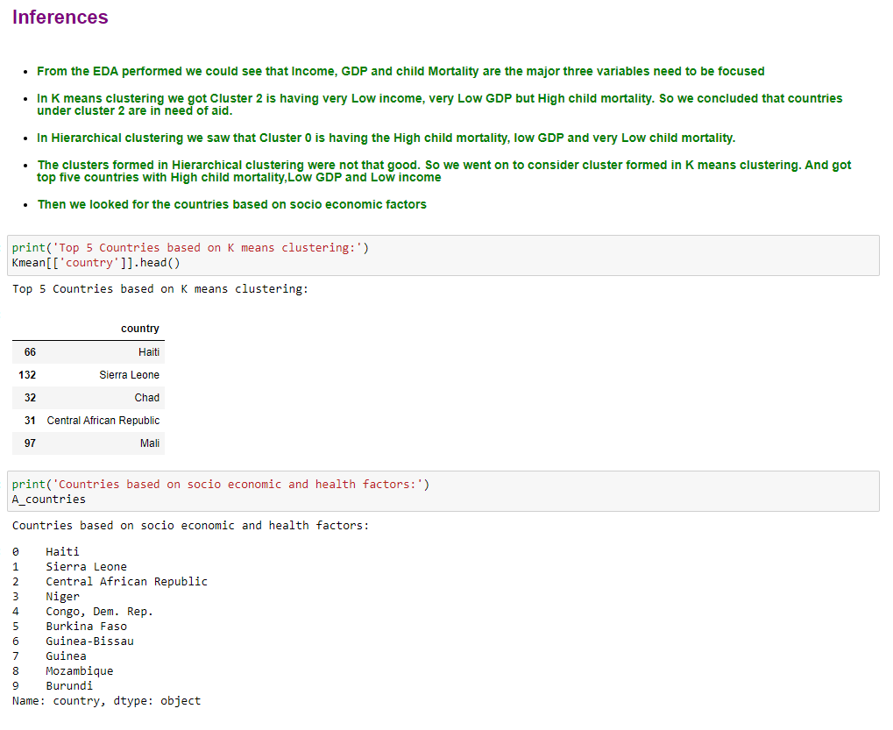

Slide 13
Recommendations
From the examination performed, We can see that low income individuals have high child mortality, so CEO should focus more on low income nations
We could likewise observe Low GDP per capita nations are not having a lot of import and export of good and services. Those nations additionally should be focused.
There are a few nations which spend well on wellbeing for individuals living in that nation. For ex: US. Such nations can be skipped. Furthermore, center more around Burundi, Congo, Dem. Rep where the absolute wellbeing spending is excessively less.
In the event that the all-out fruitfulness is less the existence expectancy is more. Haiti is the nation having extremely low life anticipation, and high child mortality. Its great to have less kids per woman, so that they could be taken care of well.

Slide 14
Thank you

